Slide 1
Mid-Scale Research Infrastructure - An Overview
Roland P. Roberts, Deputy Chief Officer for Research Facilities
Office of the Director
Matthew Hawkins, Head, Research Infrastructure Office
Office of Budget, Finance and Award Management

Slide 2
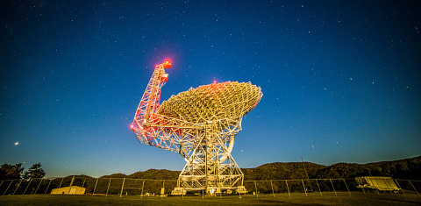
Outline
Mid-scale RI: Motivation
NSF’s Oversight
Community Building & Training
Mid-scale RI Portfolio
Status of Programs
Questions/Discussion

Slide 3
Congressional Definition of Mid-scale RI
2017 American Innovation and Competitiveness Act (AICA); Section 109 (Section 1.4.4 of the RIG):
A mid-scale project means research instrumentation, equipment, and upgrades to major research facilities or other research infrastructure investments that exceeds the maximum funded by the Major Research Instrumentation program (MRI) and are below that of a major multi-user research facility project (Major Facility).
Cost of Implementation
(Programs limits may vary and include other elements besides implementation)

Slide 4
Mid-scale RI Context Central Instrumentation and Infrastructure Implementation Programs
$0.0
$4.0 million
$20.0 million
$100.0 million
Funded by the R&RA Account Funded by the MREFC Account |  | Funded by the MREFC Account
Mid-scale RI-1 Mid-scale RI-2
Major Research Instrumentation (MRI) |  | Major Research Equipment and Facilities Construction Project (MREFC)
Existing MRI Program |  | Existing MREFC Program
22
NSF Mid-scale RI Bridge
8

Slide 5
Mid-scale RI Program Umbrella
MSRI-1 Program
Design & Implementation
(R&RA)
$400K-$20M
Program-driven Solicited
(R&RA)
Centralized NSF Programs
MSRI-2 Program
Implementation
(MREFC)
$20-$100M
PHY I-IRP Program
(R&RA)
AST MSIP Program
(R&RA)
Unsolicited Proposals
(R&RA)
Requires NSB Authorization

Slide 6
Major Facility vs. Mid-scale RI Oversight
 | RIG | Life-cycle | Stage-gate Reviews | NCOP
Major Facilities | All Sections | Development, Design, Construction, Operations, Disposition Stages | YES (CDR, PDR, FDR) | YES
Mid-scale RI | Section 5 (Other sections as appropriate) | development, design, implementation, operations, disposition | NO Mid-scale RI Track 2 “FDR-like Review” | NO
No Cost Overrun Policy (NCOP): “….require[s] that the cost estimate developed at the Preliminary Design Stage have adequate contingency to cover all foreseeable risks, and that any cost increases not covered by contingency be accommodated by reductions in scope. …NSF will identify potential mechanisms for offsetting any cost increases in accordance with this policy.”

Slide 7
Program Management and Award Oversight Programmatic Working Groups
Mid-scale RI-1: Managed by OIA
Mid-scale RI-2
Sridhar Raghavachari, BIO, sraghava@nsf.gov
Deepankar Medhi, CISE, dmedhi@nsf.gov
Jill Nelson, EDU, jnelson@nsf.gov
Aranya Chakrabortty, ENG, achakrab@nsf.gov
Frank R. Rack, GEO, frack@nsf.gov
Jonathan Friedman, OIA, jfriedma@nsf.gov
Randy L. Phelps, OIA, rphelps@nsf.gov
Chinonye Whitley, OIA, cwhitley@nsf.gov
Maija M. Kukla, OISE, mkukla@nsf.gov
John M. Papanikolas, MPS, jpapanik@nsf.gov
Joseph Whitmeyer, SBE, jwhitmey@nsf.gov
Sridhar Raghavachari, BIO, sraghava@nsf.gov
Andrey Kanaev, CISE, akanaev@nsf.gov
Lee L. Zia, EDU, lzia@nsf.gov
Joy M. Pauschke, ENG, jpauschk@nsf.gov
Margaret Benoit, GEO, mbenoit@nsf.gov
Jonathan Friedman, OIA, jfriedma@nsf.gov
Allena K. Opper, MPS, aopper@nsf.gov
Joseph Whitmeyer, SBE, jwhitmey@nsf.gov

Slide 8
Program Management and Award Oversight All Programs
Deputy Chief Officer
for Research Facilities
Awarding Directorate & Division
Cognizant Program Officers
Office of Budget, Finance and Award Management
Infrastructure Support Branch
Division of Grants and Agreements
Research Infrastructure Office

Slide 9
Community Building and Training
Project Management Webinars
Three webinars:
Webinar 1: Project Planning and Management
Webinar 2: Project Development, Definition and Risk
Webinar 3: Project Performance Management
Outreach: Partnering and Focus
EPSCoR, Geographic reach (national, regional, etc.), Institutional (ERIs, Collaboratives)

Slide 10
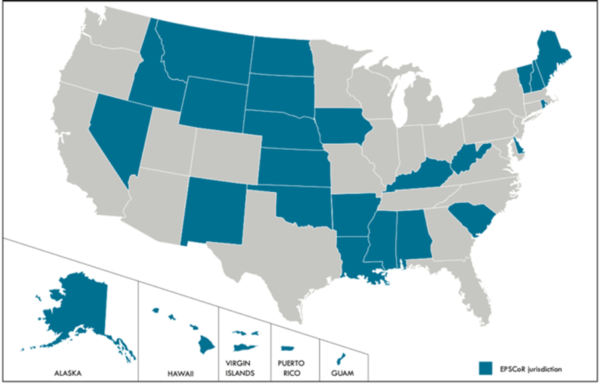
Portfolio: Geographic Distribution and Impact
Mid-scale RI-1
Awards
Subawards
Newest Track 2 Additions
Awards
Subawards
Mid-scale RI-2
Awards
Subawards

Slide 11
Mid-scale RI Programs: Current Status
NSF 23-570: the 3rd Mid-scale RI-2 competition:
NSF 22-637: the 3rd Mid-scale RI-1 competition:
Preliminary proposals (required) due January 5, 2023
Full Proposals (by invitation only) due May 5, 2023
Review in progress for FY 2024 Awards
Preliminary Proposals (Required)
June 20, 2023
Full Proposals (By Invitation Only)
December 18, 2023
Letters of Intent (Required)
May 15, 2023

Slide 12
Discussion Primers
What are pain points or challenges you have encountered in applying?
How might the process be improved to increase transparency?
Have specific needs been identified at your institution/organization that would aid more effective participation taking advantage of mid-scale funding opportunities?
What future training and guidance is needed?

Slide 13
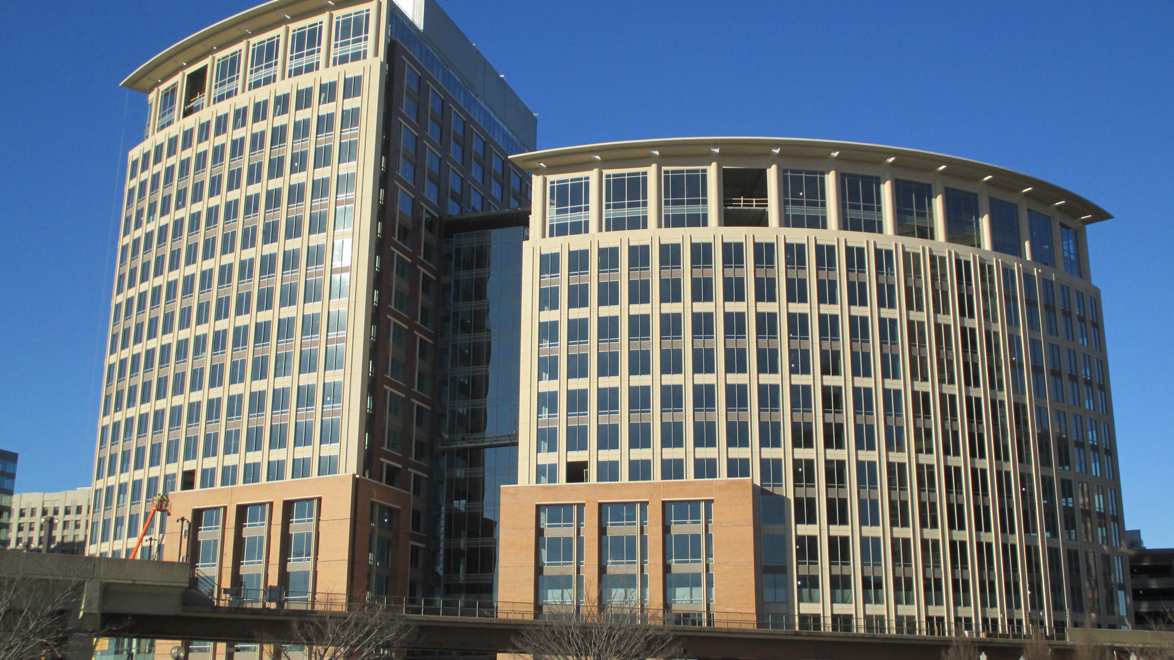
Thank You!

